Slide 1

KIET Group of Institutions Ghaziabad DEPARTMENT: CSE(AI AND ML)
MINI PROJECT by
VAIBHAV PANJIYAR
PUNEET SINGH
VAISHANV YADAV

Slide 2
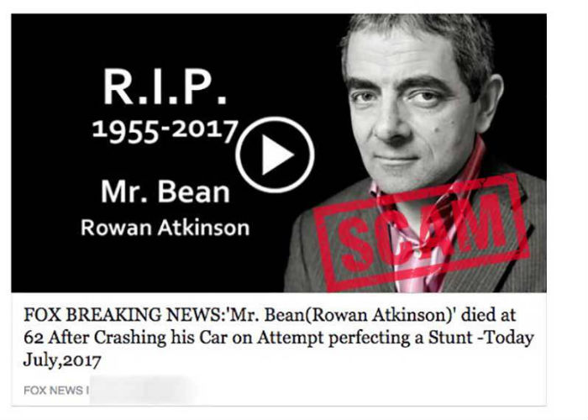
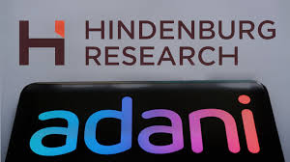
FAKE NEWS DETECTION
What is fake news?
Fake news is false or misleading information presented as news. Fake news often has the aim of damaging the reputation of a person or entity, or making money through advertising revenue.

Slide 3
OBJECTIVE
To develop a system that can classify news articles as either real or fake.
Mitigating the Spread of Misinformation:
Provide a reliable solution to identify and flag potential instances of fake news, contributing to the reduction of the inadvertent dissemination of false information.
Enhancing Media Literacy:
Facilitate media literacy by offering a tool that educates users on the characteristics of fake news and encourages critical thinking when consuming online content.
Supporting Journalistic Integrity:
Assist journalists and news organizations in verifying the authenticity of information, reinforcing their commitment to accuracy and ethical reporting.
Adapting to Evolving Threats:
Address the dynamic nature of misinformation by incorporating mechanisms for regular updates and improvements, ensuring the system remains effective against emerging trends in fake news.
Educational Tool:
Serve as an educational tool for researchers, data scientists, and enthusiasts interested in the fields of natural language processing, machine learning, and information verification

Slide 4
Tools and Technologies:
Programming Language: Python
Libraries/Frameworks: Natural Language Processing (NLP) tools (NLTK)
Machine Learning (tfidf vectorizer,
Stopword,porterstremmer)
Dataset: Fake News Dataset on Kaggle.

Slide 5
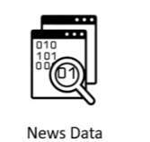

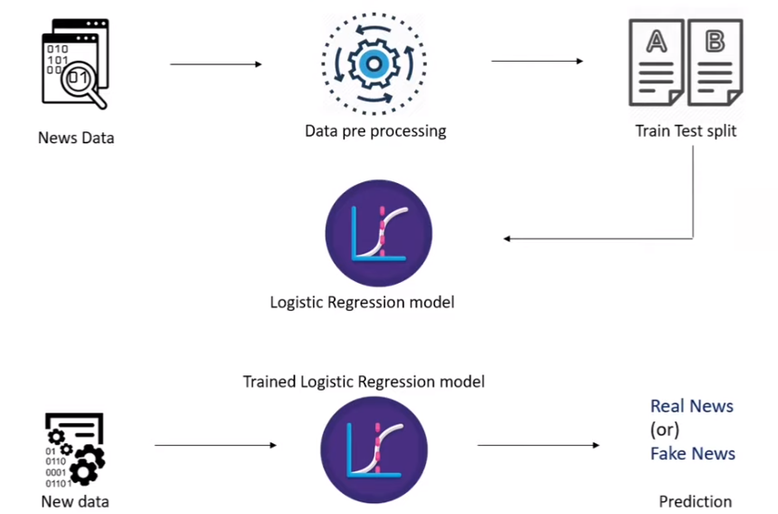
WORKFLOW

Slide 6
CONCLUSION
Fake news detection has many open issues that require attention of researchers. For instance, in order to reduce the spread of fake news, identifying key elements involved in the spread of news is an important step. Graph theory and machine learning techniques can be employed to identify the key sources involved in spread of fake news. Likewise, real time fake news identification in can be another possible future direction.

Slide 7
THANK YOU

